Slide 1
(slightly) advanced R programming
Relational and conditional operators
Loops
Introduction to writing your own functions

Slide 2
(slightly) advanced R programming
Relational and conditional operators
Loops
Introduction to writing your own functions

Slide 3
Relational operators
How does one thing (in R: object) relate to another?

Slide 4
Relational operators: Equality
How does one thing (in R: object) relate to another?
Are they the same? > ==
Output will be TRUE or FALSE.
> 4 == 12 / 3
[1] TRUE
> 3 * 3 == 4
[1] FALSE

Slide 5
Relational operators: Equality
Equality can also be enquired for logical or character objects:
> TRUE == TRUE
[1] TRUE
> “winter” == “summer”
[1] FALSE

Slide 6
Relational operators: Inequality
Are two objects NOT the same?
R operator: > !=
> 4 != 12 / 3

Slide 7
Relational operators: Inequality
Are two objects NOT the same?
R operator: > !=
> 4 != 12 / 3
[1] FALSE
> 3 * 3 != 4
[1] TRUE

Slide 8
Relational operators: Inequality
Are two objects NOT the same?
R operator: > !=
> 4 != 12 / 3
[1] FALSE
> 3 * 3 != 4
[1] TRUE
Also works with logicals and characters:
> “winter” != “summer”
[1] TRUE
> TRUE != TRUE
[1] FALSE

Slide 9
Relational operators: greater or smaller than
R operators: > or <
> 12 < 23
[1] TRUE
> 12 < 9
[1] FALSE
> 12 > 9
[1] TRUE

Slide 10
Relational operators: greater or smaller than
R operators: > or <
> 12 < 23
[1] TRUE
> 12 < 9
[1] FALSE
> 12 > 9
[1] TRUE
Also works on characters…
> “my_yacht” > “your_yacht”

Slide 11
Relational operators: greater or smaller than
R operators: > or <
> 12 < 23
[1] TRUE
> 12 < 9
[1] FALSE
> 12 > 9
[1] TRUE
Also works on characters…
> “my_yacht” > “your_yacht”
[1] FALSE
..since ‘m’ is further down the alphabet than ‘y’

Slide 12
Relational operators: greater or smaller than
R operators: > or <
> 12 < 23
[1] TRUE
> 12 < 9
[1] FALSE
> 12 > 9
[1] TRUE
Also works on characters…
> “my_yacht” > “your_yacht”
[1] FALSE
…and logical objects
> TRUE > FALSE
[1] TRUE
Greater or equal: >=
Smaller or equal: <=
..since ‘m’ is further down the alphabet than ‘y’
TRUE is a computational 1;
FALSE is a 0

Slide 13
Relational operators work on vectors
A vector of counts of tiger sharks counts…
> tiger <- c(0, 4, 1, 1, 4, 5, 2, 0, 9)
On which days were there tiger sharks in the water?
> tiger > 0
[1] FALSE TRUE TRUE TRUE TRUE TRUE TRUE FALSE TRUE
…or:
> tiger >= 1
[1] FALSE TRUE TRUE TRUE TRUE TRUE TRUE FALSE TRUE

Slide 14
Relational operators work on vectors
A vector of counts of tiger sharks counts…
> tiger <- c(0, 4, 1, 1, 4, 5, 2, 0, 9)
… and of hammerhead sharks:
> hammerheads <- c(1, 2, 4, 5, 2, 0, 1, 1, 4)
When were there more tiger than hammerhead sharks?
[1] FALSE TRUE FALSE FALSE TRUE TRUE TRUE FALSE TRUE

Slide 15
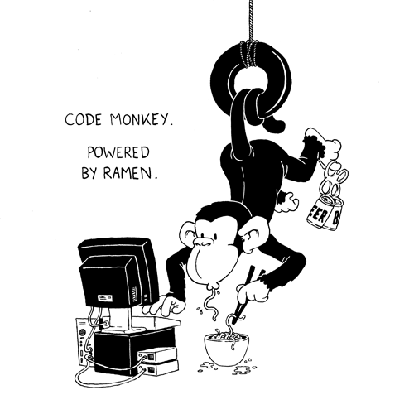
Exercise 01 and 02
http://farmecologie.com/wp-content/uploads/2011/10/4031165773_79716123bf_o1.gif

Slide 16
Logical operators
AND operator: &
OR operator: |
NOT operator: !

Slide 17
Logical operators
AND operator: &
OR operator: |
NOT operator: !
Returns TRUE if both statements are TRUE.
> 12 < 23 & 12 > 5
[1] TRUE

Slide 18
Logical operators
AND operator: &
OR operator: |
NOT operator: !
Returns TRUE if both statements are TRUE.
> 12 < 23 & 12 > 5
[1] TRUE
One of the logical values must evaluate to TRUE.
> 12 < 23 & 12 < 5
[1] FALSE
> 12 < 23 | 12 < 5
[1] TRUE

Slide 19
Logical operators
AND operator: &
OR operator: |
NOT operator: !
Returns TRUE if both statements are TRUE.
> 12 < 23 & 12 > 5
[1] TRUE
One of the logical values must evaluate to TRUE.
> 12 < 23 & 12 < 5
[1] FALSE
> 12 < 23 | 12 < 5
[1] TRUE
> !TRUE > !(12 > 5) > !is.numeric(“winter”)

Slide 20
Logical operators
AND operator: &
OR operator: |
NOT operator: !
Returns TRUE if both statements are TRUE.
> 12 < 23 & 12 > 5
[1] TRUE
One of the logical values must evaluate to TRUE.
> 12 < 23 & 12 < 5
[1] FALSE
> 12 < 23 | 12 < 5
[1] TRUE
> !TRUE > !(12 > 5) > !is.numeric(“winter”)
[1] FALSE [1] FALSE [1] TRUE

Slide 21

Exercises 3 and 4

Slide 22
Conditional execution
Use results of relational operators and logical operators to change behaviour of your code
> if(condition) {
this_will_happen
}

Slide 23
Conditional execution
Use results of relational operators and logical operators to change behaviour of your code
> if(condition) {
this_will_happen
}
> season <- “winter”
> if(season == winter) {
print(“Damn cold!”)
}
[1] “Damn cold!”

Slide 24
Conditional execution
Use results of relational operators and logical operators to change behaviour of your code
> if(condition) {
this_will_happen
}
> season <- “winter”
> if(season == “winter”) {
print(“Damn cold!”)
}
[1] “Damn cold!”
> season <- “summer”
> if(season == “winter”) {
print(“Damn cold!”)
}
>

Slide 25
Conditional execution
Use results of relational operators and logical operators to change behaviour of your code
> if(condition) {
this_will_happen
} else {
that_will_happen
}

Slide 26
Conditional execution
Use results of relational operators and logical operators to change behaviour of your code
> if(condition) {
this_will_happen
} else {
that_will_happen
}
> season <- “summer”
> if(season == “winter”) {
print(“Damn cold!”)
} else {
print(“Slightly less cold.”)
}
[1] “Slightly less cold.”

Slide 27
Conditional execution
Use results of relational operators and logical operators to change behaviour of your code
> if(condition) {
this_will_happen
} else if(condition2) {
that_happens
} else {
that_will_happen
}

Slide 28
Conditional execution
Use results of relational operators and logical operators to change behaviour of your code
> if(condition) {
this_will_happen
} else if(condition2) {
that_happens
} else {
that_will_happen
}
> season <- “summer”
> if(season == “winter”) {
print(“Damn cold!”)
} else if(season == “summer”) {
print(“Slightly less cold.”)
} else {
print(“Probably rainy.”)
}
What will be the printout?

Slide 29
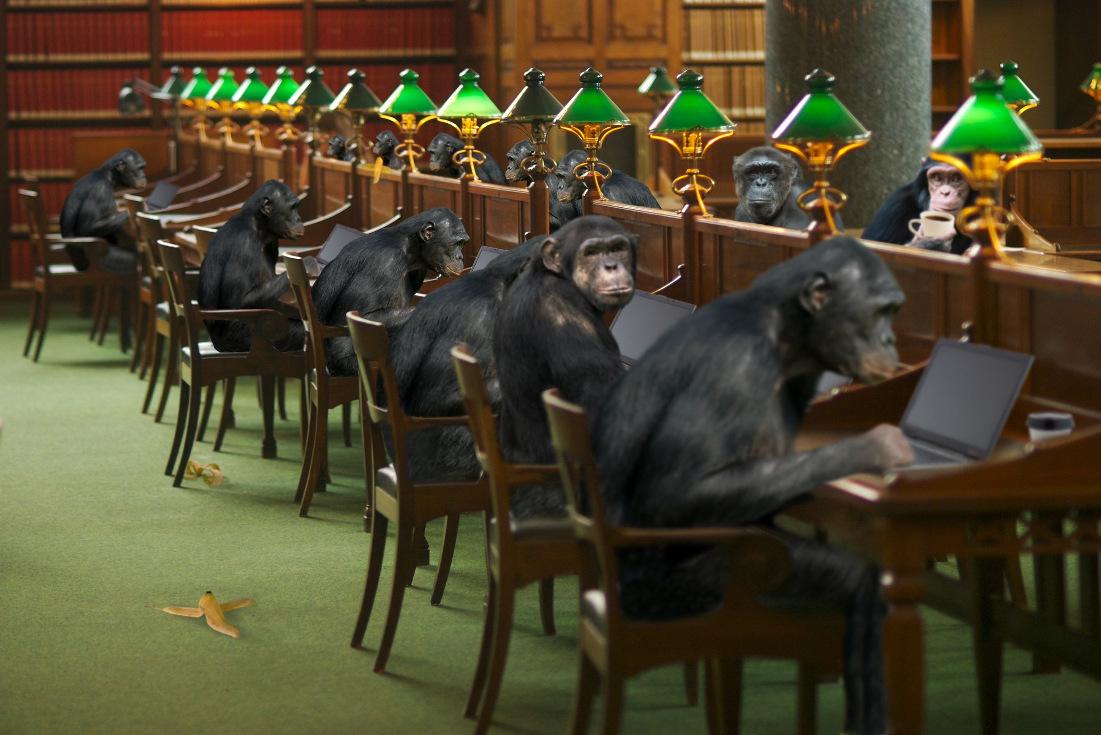
Exercise 5
makeitmine.com.au

Slide 30
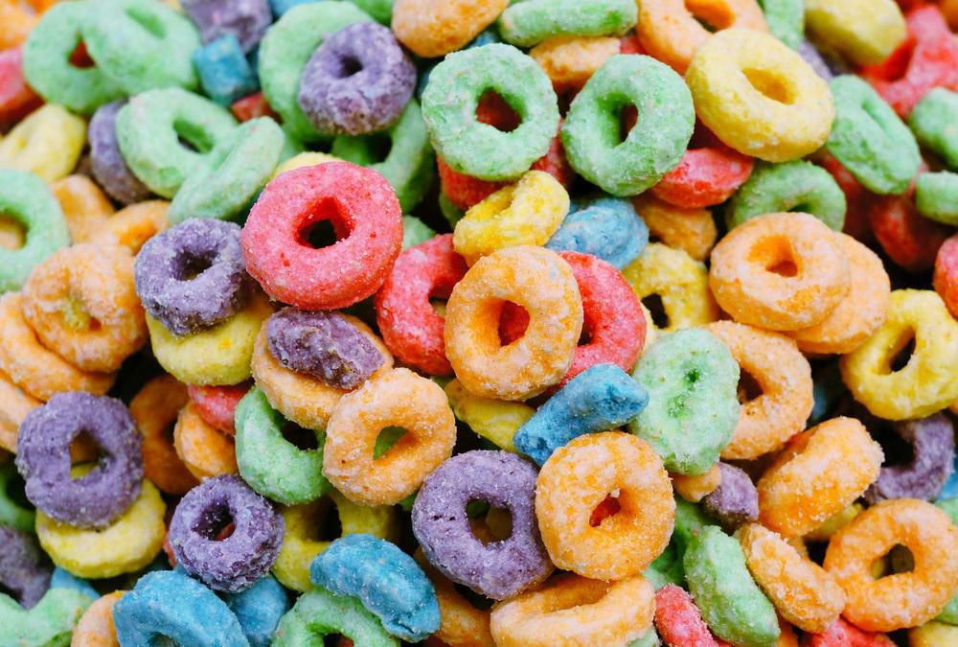
(slightly) advanced R programming
Relational and conditional operators
Loops – Repetitive execution
Introduction to writing your own functions

Slide 31
Repetitive execution: while loops
An expression is executed, as long as a condition is TRUE.
> while(condition) {
expression
}

Slide 32
Repetitive execution: while loops
An expression is executed, as long as a condition is TRUE.
> while(condition) {
expression
}
> i <- 1
> while(i < 10) {
print(paste0(“Two times i is “, i * 2))
i <- i + 1
}

Slide 33
First round of the while loop
i is 1
Condition is TRUE
Expression is printed…
…and i increased by 1
Loop goes into 2nd round
> i <- 1
> while(i < 10) {
print(paste0(“Two times i is “, i * 2))
i <- i + 1
}
[1] “Two times i is 2”

Slide 34
Second round of the while loop
i is now 2
Condition is still TRUE
Expression is printed…
…and i increased by 1
Loop goes into 3nd round
…3…4…5…6…7…8…9…
> while(i < 10) {
print(paste0(“Two times i is “, i * 2))
i <- i + 1
}
[1] “Two times i is 4”

Slide 35
Tenth round of the while loop
i is now 10
Condition now FALSE
Expression not run…
…and i not increased
Loop stops
What would be my output?
> while(i < 10) {
print(paste0(“Two times i is “, i * 2))
i <- i + 1
}

Slide 36
Tenth round of the while loop
i is now 10
Condition now FALSE
Expression not run…
…and i not increased
Loop stops
What would be my output?
> while(i < 10) {
print(paste0(“Two times i is “, i * 2))
i <- i + 1
}
No printout! But let’s check i:
> i
[1] 10

Slide 37
Spot the problem in this while loop:
> i <- 1
> while(i < 10) {
print(paste0(“Two times i is “, i * 2))
}
[1]

Slide 38

Spot the problem in this while loop:
> i <- 1
> while(i < 10) {
print(paste0(“Two times i is “, i * 2))
}
[1] “Two times i is 2”
[1] “Two times i is 2”
[1] “Two times i is 2”
[1] “Two times i is 2”
[1] “Two times i is 2”
[1] “Two times i is 2”

Slide 39
break and stop your loop
> i <- 1
> while(i < 10) {
if(i * 2 == 10) {
break
}
print(paste0(“Two times i is “, i * 2))
i <- i + 1
}
break will stop the loops operations
What would be the printout of this loop?

Slide 40
break and stop your loop
> i <- 1
> while(i < 10) {
if(i * 2 == 10) {
break
}
print(paste0(“Two times i is “, i * 2))
i <- i + 1
}
break will stop the loops operations
What would be the printout of this loop?
[1] “Two times i is 2“
[1] “Two times i is 4“
[1] “Two times i is 6“
[1] “Two times i is 8“
… and then it stops.

Slide 41

Exercise Loops: 1
fasttech.com

Slide 42
Repetitive execution: for loops
for(variable in sequence) {
expression
}
> my_seq <- c(1, 11, 111, 1111)
> for(i in my_seq) {
print(i)
}
[1] 1
[1] 11
[1] 111
[1] 1111

Slide 43
Repetitive execution: for loops
for(variable in sequence) {
expression
}
> sharks <- list(“tiger”, “hammerhead”, “lemon”, “bull”)
> for(species in sharks) {
print(species)
}
What will be the printout?

Slide 44
Repetitive execution: for loops
for(variable in sequence) {
expression
}
> sharks <- list(“tiger”, “hammerhead”, “lemon”, “bull”)
> for(species in sharks) {
print(species)
}
[1] “tiger”
[1] “hammerhead”
[1] “lemon”
[1] “bull”

Slide 45
Repetitive execution: break (revisited)
for(variable in sequence) {
expression
}
break stops loop execution
> sharks <- list(“tiger”, “hammerhead”, “lemon”, “bull”)
> for(species in sharks) {
if(species == “lemon”) {
break
}
print(species)
}
What will be the printout?

Slide 46
Repetitive execution: break (revisited)
for(variable in sequence) {
expression
}
break stops loop execution
> sharks <- list(“tiger”, “hammerhead”, “lemon”, “bull”)
> for(species in sharks) {
if(species == “lemon”) {
break
}
print(species)
}
[1] “tiger”
[1] “hammerhead”

Slide 47
Repetitive execution: next
for(variable in sequence) {
expression
}
break stops loop execution
next skips the current iteration
> sharks <- list(“tiger”, “hammerhead”, “lemon”, “bull”)
> for(species in sharks) {
if(species == “lemon”) {
next
}
print(species)
}
[1] “tiger”
[1] “hammerhead”
[1] “bull”

Slide 48
for loop with looping index
> sharks <- list(“tiger”, “hammerhead”, “lemon”, “bull”)
> for(species in sharks) {
print(species)
}
[1] “tiger”
[1] “hammerhead”
[1] “lemon”
[1] “bull”

Slide 49
for loop with looping index
> sharks <- list(“tiger”, “hammerhead”, “lemon”, “bull”)
> for(species in sharks) {
print(species)
}
[1] “tiger”
[1] “hammerhead”
[1] “lemon”
[1] “bull”
But what if I want to know the position of “lemon sharks” in the “sharks” vector?

Slide 50
for loop with looping index
> sharks <- list(“tiger”, “hammerhead”, “lemon”, “bull”)
> for(i in 1:length(sharks)) {
print(sharks[[i]])
}
> sharks <- list(“tiger”, “hammerhead”, “lemon”, “bull”)
> for(species in sharks) {
print(species)
}
[1] “tiger”
[1] “hammerhead”
[1] “lemon”
[1] “bull”

Slide 51
for loop with looping index
> sharks <- list(“tiger”, “hammerhead”, “lemon”, “bull”)
> for(i in 1:length(sharks)) {
print(sharks[[i]])
}
[1] “tiger”
[1] “hammerhead”
[1] “lemon”
[1] “bull”
> sharks <- list(“tiger”, “hammerhead”, “lemon”, “bull”)
> for(species in sharks) {
print(species)
}
[1] “tiger”
[1] “hammerhead”
[1] “lemon”
[1] “bull”

Slide 52
for loop with looping index
> sharks <- list(“tiger”, “hammerhead”, “lemon”, “bull”)
> for(i in 1:length(sharks)) {
print(paste0(sharks[[i]], “ is #“,
i, “ in the sharks list”))
}
Output is the same as before, but now I can access the position of the species in the vector. And use it.
What will be the printout?

Slide 53
for loop with looping index
> sharks <- list(“tiger”, “hammerhead”, “lemon”, “bull”)
> for(i in 1:length(sharks)) {
print(paste0(sharks[[i]], “ is #“,
i, “ in the sharks list”))
}
[1] "tiger is #1 in the sharks list"
[1] "hammerhead is #2 in the sharks list"
[1] "lemon is #3 in the sharks list"
[1] "bull is #4 in the sharks list"
Output is the same as before, but now I can access the position of the species in the vector. And use it.

Slide 54

Exercise Loops: 2 & 3
xcombear.ru

